Slide 1
PlotPal
An R Shiny App to Create Preliminary Graphs for your Data

Slide 2
Background
These data were generated for my dissertation project. Because this class is requiring us to publish our apps and presentations, and because these data are not published, I have anonymized certain aspects of the data, including the names of the compounds and the names of the genes of interest.
This project is focused on liver-critical nuclear receptor transcription factors that are important in the development of liver cancer. Wild type and knock out rats are treated with known activators for each transcription factor.
After the treatment period ends, the animals are euthanized, and tissues are collected. Initial measurements include Pre- and post-euthanasia body weight, liver weight, liver to body weight ratio, and serum ALT levels.
Why are these data interesting?
Observations from these data can tell us more about how activation of liver-critical transcription factors can affect liver function, and therefore liver health.
The data include categorical variables and continuous numerical variables. I believe this allows for sufficient complexity to justify its use.
I chose this dataset despite having to anonymize it because the goal was to build an app that would be useful for myself as well as for others who need a quick tool to graph and analyze their own preliminary data.

Slide 3
What does PlotPal Do?
PlotPal is a data visualization tool. It allows users to upload their own data and create graphs in order to draw preliminary insights from that data.
PlotPal is versatile in that it allows users to graph several different types of plots, including scatter, bar, box, and line plots as well as histograms
The bar and box plots have been set up to calculate the mean of the user’s chosen Y value in order to generate the plot. This is because there is likely multiple individuals represented in a variable such as liver-to-body weight (LW-BW) ratio.

Slide 4
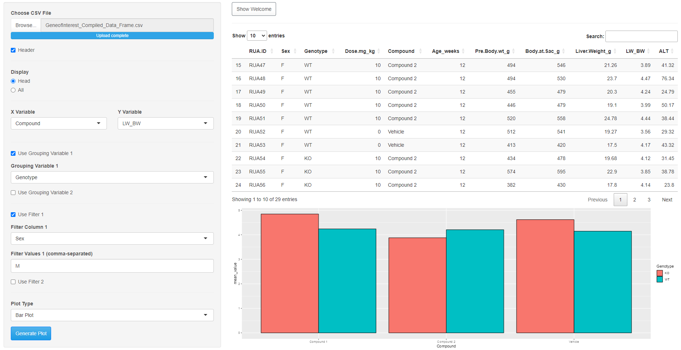
What does PlotPal Do?
For example, this bar plot utilizes the “Grouping Variable” to specify genotype. There are five individuals in each compound/genotype group. The mean value has been calculated for each group.
With this, we can see that knockout individuals have higher LW-BW ratios with compounds 1 and vehicle, but the opposite is true for compound 2. This indicates that compound 2 is potentially activating compensatory mechanisms that prevent the increase in LW-BW ratio seen in KO animals treated with compound 1 or the vehicle.

Slide 5
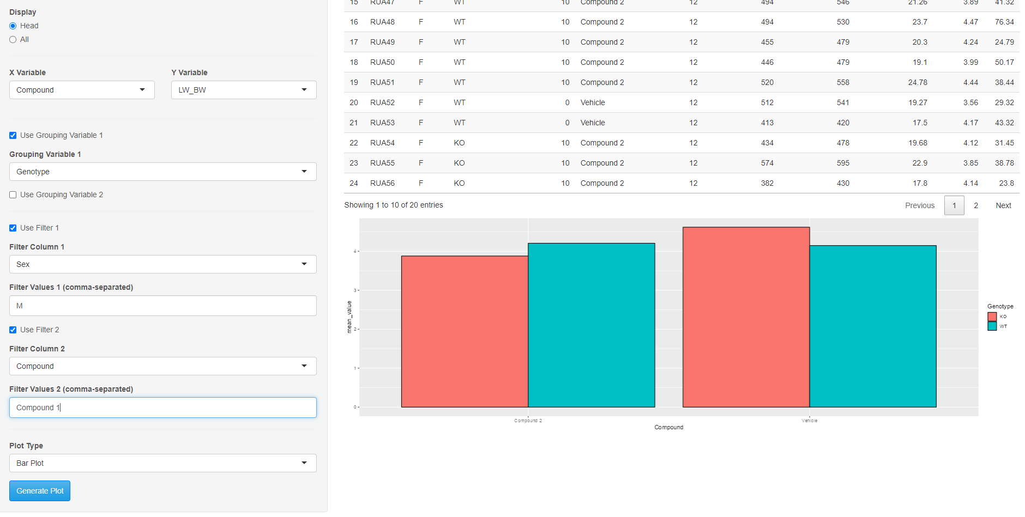
What does PlotPal Do?
Two filter options have been used for added versatility. In the case above, the data is filtered to show only LW-BW ratio for females given compound 2 and vehicle.
In addition, it has been filtered so the user is able to see the difference between a single group and the vehicle control rather than all three groups.

Slide 6
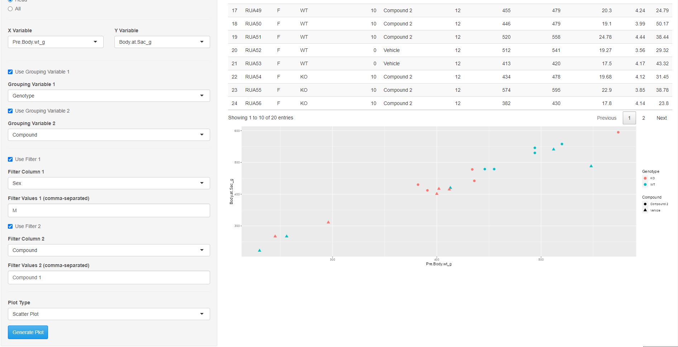
What does PlotPal Do?
There is also an option for a second grouping variable, which could be necessary for more complex data and plot types.
In the image above, a second grouping variable is used for the scatter plot so we see WT and KO animals as well as whether the animals were given compound 2 or vehicle. This lets us more closely analyze each group.
Here, we can see that body weight appears to have increased for WT animals more so than KO animals with or without treatment. In addition, KO animals treated with compound 2 appear to have increased in weight more so than KO animals treated with vehicle only. This increase in weight could give some insight into why LW:BW ratio decreased in compound 2 treated KO animals compared to the other groups.

Slide 7
What does PlotPal Do?
Data from biological studies can be exceedingly complex and require grouping and filtering versatility.
The idea behind PlotPal is to provide this versatility in a way that allows it to be customizable to the dataset uploaded by the user.
The user is not required to use the Grouping and Filter functions, but they are available if the data visualization requires them.
Preliminary visualizations can help identify early patterns in research data, which can help researchers fine-tune future directions for experiments.
For example, I have identified a pattern that shows a decrease in LW-BW ratio in KO animals treated with compound 2 as well as an increase in Post-euthanasia body weight.
Does this mean compound 2 is disrupting metabolism (causing weight gain) but not impacting the liver directly?

Slide 8
Github
Please use the following link to find my app and the example dataset on Github:
https://github.com/kstunkard31/Test-Repo

